Slide 1
Syrian Arab Republic — Syrian Private University
Faculty of Informatics Engineering — Software Engineering & Information Systems
Smart Humanitarian Aid Ecosystem
Athar Platform & App
AI-Driven Relief Governance with Smart NFC Cards & Interactive GIS
Prepared By
Supervised By
Khalil Tarek Al-Hanafi & Ibrahim Mohammad Wasim Lotfi
Dr. Kadan Al-Jumaa

Slide 2


Part 1: Project Objective
Transforming Relief into Smart Systems
Centralized Aid Data
User Survey Finding
Unified relief cases classified by governorate urgency.
70%
Anti-Fraud Governance
Fair distribution via NFC cards plus AI auditing.
Distrust Unverified Aid Posts
Athar replaces chaotic social media groups with verified digital governance.
Rapid Field Response
Direct coordination between NGOs plus field volunteers.

Slide 3



Part 2: Previously Executed Phases (Project 1)
Analytical & Core System Foundation
Field Analysis
Role Hierarchy
Core Case Engine
Regional Filtering
Expert interviews plus youth surveys.
Four distinct user permission levels.
Verified case publishing workflow.
Case filtering across Syrian governorates.
Project 1 Deliverable: UML modeling plus initial Flutter authentication screens

Slide 4
Part 3: Literature Review
Benchmarking Athar Against Alternatives
Comparison Metric | Athar Platform (v2) | Ehsan App (KSA) | ShareTheMeal | Social Groups
User Roles | Donor, NGO, Volunteer, Admin | Donor & charity portals | Financial donor only | Unstructured public posts
Fraud Detection | Image hash plus AI audit | Gov API verification | Central UN campaigns | High fake case risk
Field Delivery | NFC cards plus inventory | Digital payouts only | No volunteer dispatch | Manual chat tracking
Priority Triage | Arabic NLP auto-scoring | Institutional rules | Macro funding pools | By post date only
Spatial Coverage | Interactive GIS heatmaps | Region-level filtering | Country-level view | Manual text search

Slide 5
Part 4: Project Execution Phases
Six-Phase Incremental Development Path
Phase 1 (Project 1)
Phase 2 (New)
Phase 3 (New)
Core Foundation
Citizen Portal
Field Automation
Auth plus case management
ShamCash plus impact reels
NFC cards plus warehouses
Phase 4 (New)
Phase 5 (New)
Phase 6 (New)
AI Intelligence
Web Command Center
Quality Assurance
NLP triage plus fraud checks
GIS maps plus impact reports
End-to-end automated testing

Slide 6
New Project 2 Modifications — Part 1
Field Automation & Citizen Experience
Field & Warehouse Automation
Citizen & Donor Experience
Smart NFC Beneficiary Cards
ShamCash Donation Gateway
Instant field scanning prevents duplicate aid claims.
Seamless local financial contributions per case.
Warehouse Inventory Tracking
Aid Request Wizard & Tracker
Real-time stock monitoring across relief campaigns.
Guided aid submission with live status updates.
Digital Volunteer Passport
Field Impact Stories Reels
Verified service hours with SHA-256 certificates.
Short vertical videos documenting delivered aid.

Slide 7




New Project 2 Modifications — Part 2
Embedded Backend AI Intelligence Suite
Arabic NLP Triage
Image Fingerprinting
Document Auditor
Shelter Analyzer
Automated urgency scoring for cases.
Perceptual hashing blocks duplicate photos.
Automated verification of official files.
Visual structural damage assessment.
Smart Matchmaker: Automated volunteer assignment based on field skills

Slide 8



Part 5: Tools & Technologies Used
System Architecture & Technology Stack
Flutter Mobile Application (Clean Architecture + BLoC)
Modular domain layers featuring NFC scanning plus 3D card simulation.
Laravel 12 Backend & Web Command Center
Secured RESTful APIs powering 14 administrative views plus GIS heatmaps.
PostgreSQL Database & Automated Testing Suite
Relational spatial storage verified via 29 automated PHPUnit plus Flutter tests.

Slide 9
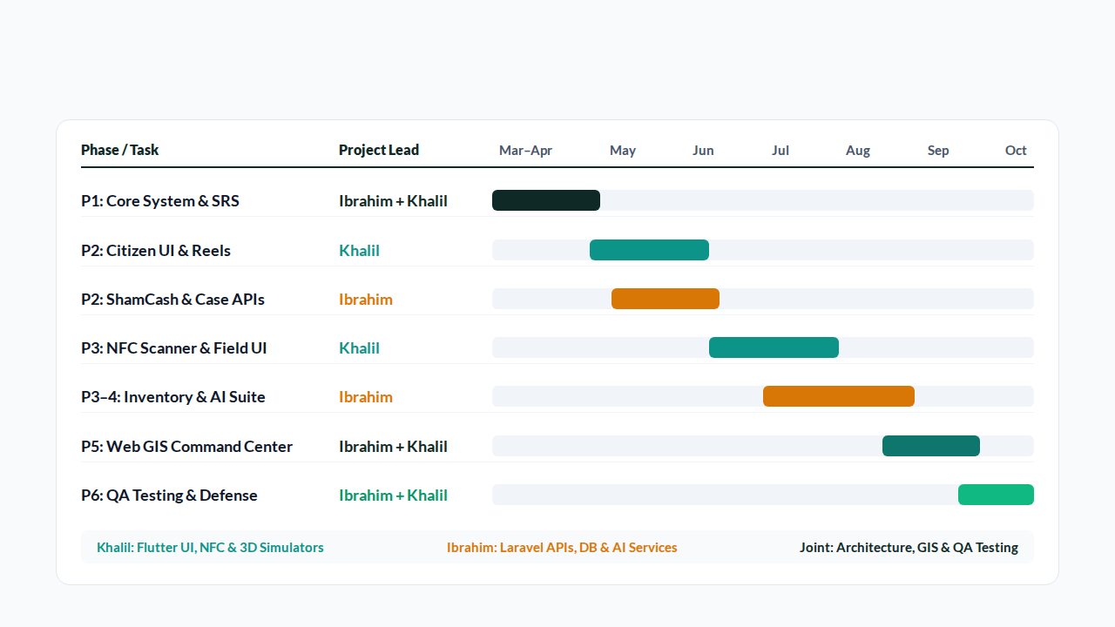
Part 6: Project Execution Plan
Gantt Chart & Team Task Allocation

Slide 10

Syrian Private University — Graduation Project 2
Thank You for Listening
We welcome your questions and feedback
Khalil Tarek Al-Hanafi & Ibrahim Mohammad Wasim Lotfi

